Slide 1
Word 1
Microsoft Word 2013

Slide 2
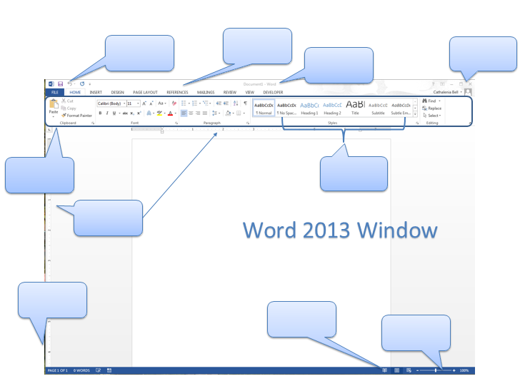
Top Level
Tabs
Minimize
Restore
Close
Quick Access Toolbar
Title Bar
Ribbon
Group
Rulers
Status Bar
View Buttons
Zoom Control

Slide 3
Getting to Know Word
Word is word processing software.
You can use it to type letters, reports, and other documents
The File Tab is the central location for managing and sharing documents.
When you click on the File Tab, you are in backstage view.

Slide 4
Useful Commands and Shortcuts
Open a file
File tab > Open
Ctrl+O
Save a file
File tab> Save
Ctrl+S
Save with new name or location
File tab> Save as
Saving in a different File format→ PDF—Save As, change file type to PDF
Printing
Ctrl + P

Slide 5
Select and Highlight Text
Select a word
Double click on the word
Select a sentence
Ctrl + Click anywhere in the sentence
Select a paragraph
Triple click anywhere in the paragraph
Select the whole document a
(Home-Select-Select All)
Ctrl + A

Slide 6
Cut—Copy--Paste
Cut
Cut
Shortcut is Ctrl+X
Right click is Cut
Copy
Shortcut is Ctrl+C
Right click is Copy
Paste
Shortcut is Ctrl+V
Right click is Paste (clipboard)
Copy
Paste

Slide 7
More Tools
Besides cut and paste, text can also be dragged and dropped
Other useful tools include:
Undo or Ctrl+Z
Redo or Ctrl+Y
The Clipboard is the temporary storage for copied text
The clipboard can be accessed through the dialog box launcher
Quick Access toolbar
Dialog Box Launcher

Slide 8
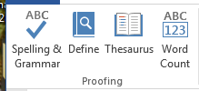
Spelling
Check spelling
Review tab> Proofing group
Auto correct automatically corrects common spelling errors
AutoCorrect can be found in the proofing section of the Options in the File tab.
Auto complete will guess certain words
Incorrect spelling is underlined in red
Incorrect grammar is underlined in green

Slide 9
Alignment
Left
Right
Center shortcut is Ctrl+E
Left shortcut is Ctrl+L
Right shortcut is Ctrl+R
Justify shortcut is Ctrl+J
Vertical alignment is from top to bottom
Page Layout tab> Page set up group> Dialog Box Launcher > Layout Tab>Page Section
Types are Center, Top, Bottom and Justify
Horizontal Alignment is left and right
Justify
Center

Slide 10
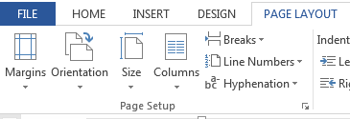
Margins
To set margins
Page Layout Tab> page set up group> Margins button
Default margins are 1 inch

Slide 11
Line Spacing
Default line spacing is 1”
Home tab> Paragraph group
Line Spacing Shortcuts
Double is Ctrl+2
Single is Ctrl+1
1.5 is Ctrl+5

Slide 12
Font
Changing Font face and Font size
Home tab> font group
Emphasizing text
Bold= Ctrl + b
Italics= Ctrl + i
Underline= Ctrl + u

Slide 13
Font (cont)
Format painter
Copies styles and appearance, not text and content— Copies Formatting
Click painter twice to copy to more than one location
Change Case
shift+F3
Icon

Slide 14
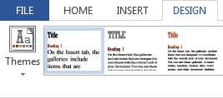
Themes & Styles
Styles include pre-formatted
Font and Font Size
Styles are located
Home tab> Styles group
Themes are sets of formats for
Fonts, Colors, Graphics
Themes are located
Design tab> Document Formatting group

Slide 15
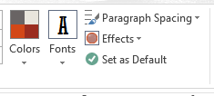
Themes & Styles (cont)
Themes will only appear if a style has been applied
Changing Themes without applying Styles will only change your color options
Items in the Themes group include
Themes
Color
Font
Effects

Slide 16
Page Borders
Page Borders place a border around the whole page.
The path to Page Borders is Design Tab→Page Backround Group→Page Border
Page borders can be art, colored, different widths and/or lines.

Slide 17
Headers & Footers
Headers are at the Top of the page
Footers are at the bottom of the page
Path to create
Insert tab> Header & Footer group
Automatic page numbers can be placed in a document by going to
Insert tab>Header/Footer group>page numbers
The locations for page numbers are: Top, Bottom, Margins, Current
Use the Design Tab to add page numbers when the Header & Footer are active

Slide 18
Class Format
Class format for Header and Footer
Student Name assignment Period
Date Page # Teacher
Header
Footer

Slide 19
Bullets and Numbering
A Numbered List is used when items appear sequentially.
A Bulleted list is used when order does not matter
Custom bullets can be defined by choosing define new bullet
Custom numbering can be defined by choosing define new number format

Slide 20
Printing
Print Preview lets you view a document as it will appear printed
Click the File tab and choose Print—This will allow you to use Print Preview as well.
There are two ways (orientation) to print (found in the Print Layout tab)
Portrait (Tall)
Landscape (Wide)

