Slide 1
Web Design Etiquette

Slide 2
Small is Beautiful
Large pages a pain to download – remember that people are using dial-up modems still.
Use carefully selected images and graphics
Keep the design simple

Slide 3
Be Kind to Others
Different web browsers such as Firefox, Explorer, Chrome (sadly) are not the same
Exotic effects do not translate well
Test your website on different browsers/

Slide 4
Make a Good Read
Make sure that the style of the text is readable.
Use a sans-serif font not a serif font
The easiest color to read is black text on a white background.

Slide 5
Edit, Edit, Edit
Proofread everything, if one word misspelled, it shines like a beacon.
Poor grammar announces poor editing skills.
Edit until you are satisfied, then edit some more.
Good tip: Put your paragraphs into Microsoft Word and use the grammar and spell checker.
Everybody on the world wide web is going to see your work!

Slide 6
Test your links!!!
If a link is not working anymore, it is frustrating.
Click on everything, find the mistake, and fix it.

Slide 7
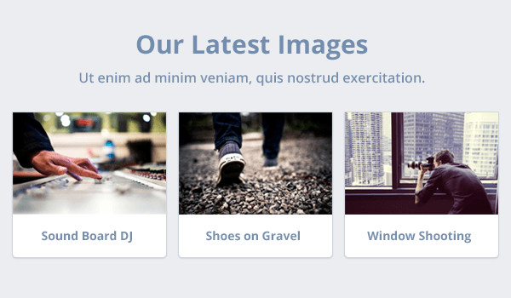
Color
Loud color vs. subtle color

Slide 8
Color continued
Start with a greyscale base
Choose one color to highlight. Keep the color scheme simple.
If you have a hard time choosing a highlight color, choose blue and vary the different shades and hues of blue.

